Slide 1
Requirement Analysis and Specification Document
Software engineering 2
Giulia Pennati
Paola Sanfilippo
Marco Siracusa

Slide 2
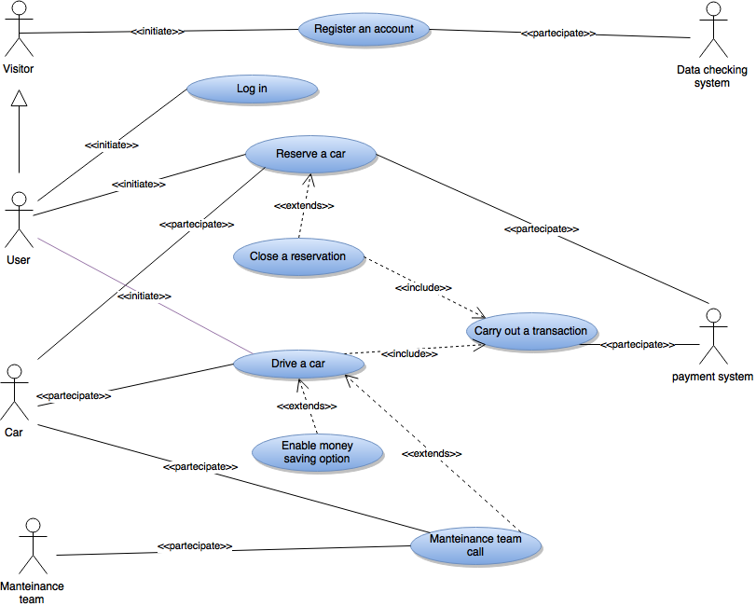
Use case diagram

Slide 3
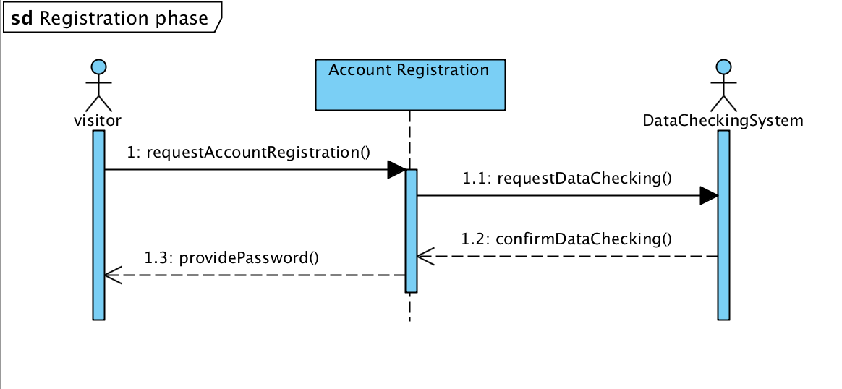
Sequence diagram - registration

Slide 4
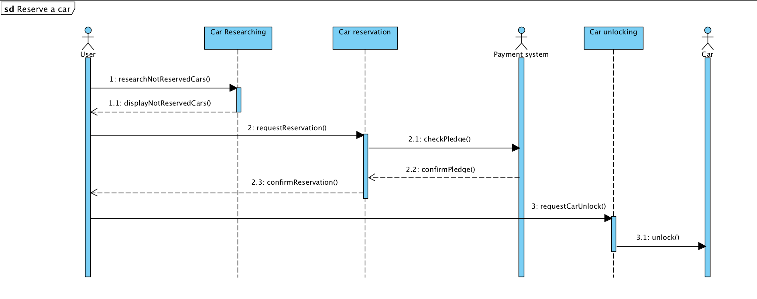
Sequence diagram – research and reservation

Slide 5
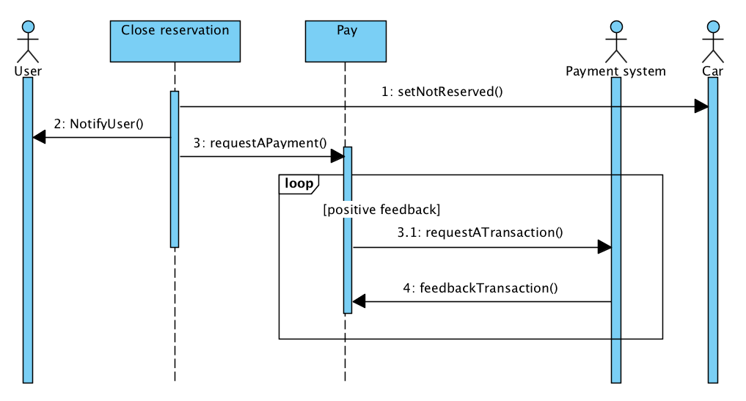
Sequence diagram – close reservation

Slide 6
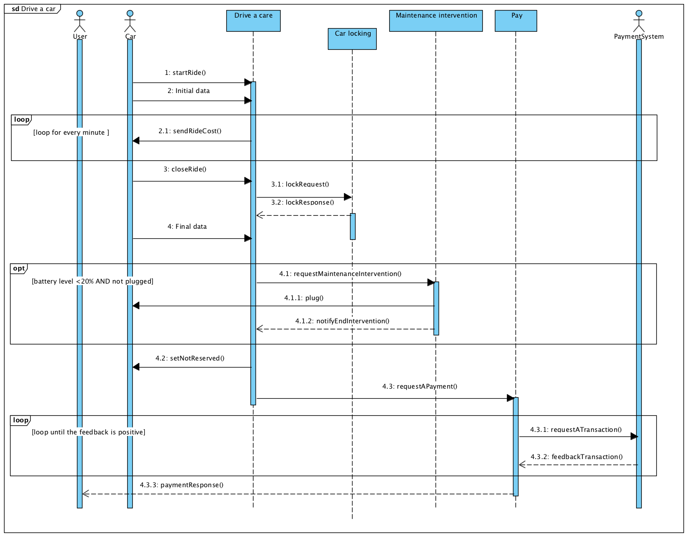
Sequence diagram – drive a car

Slide 7
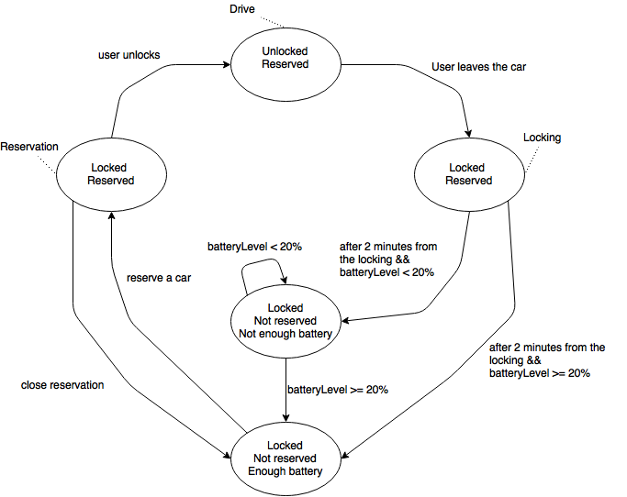
State chart – car’s status

Slide 8
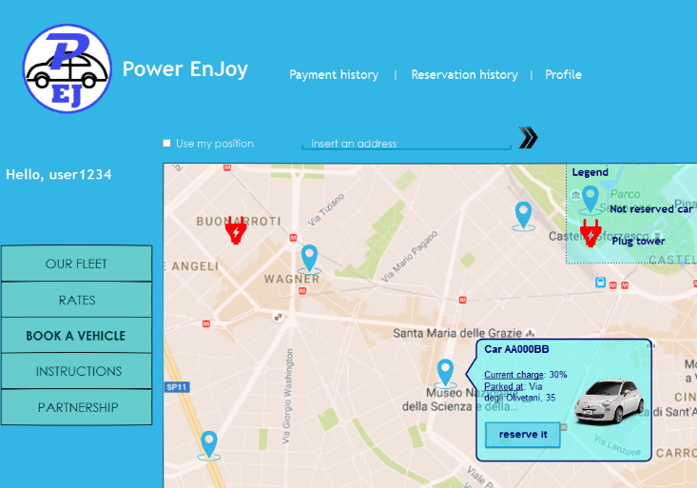
Mockup desktop - Research

Slide 9
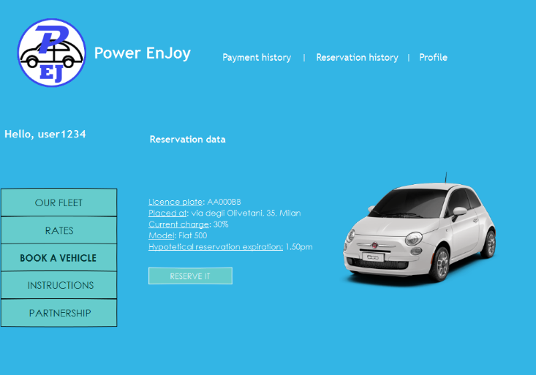
Mockup desktop – Reservation

Slide 10
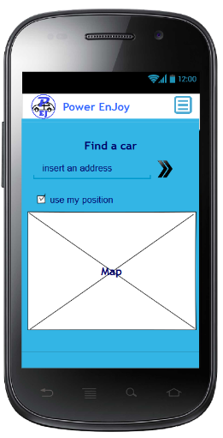
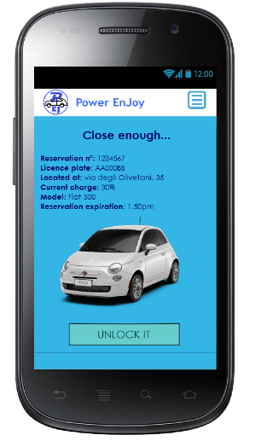
Mockup mobile – Research, reservation and unlock

Slide 11
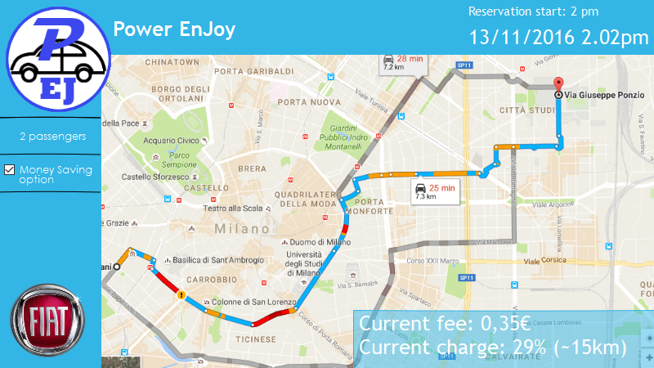
Mockup car screen – a general view

Slide 14
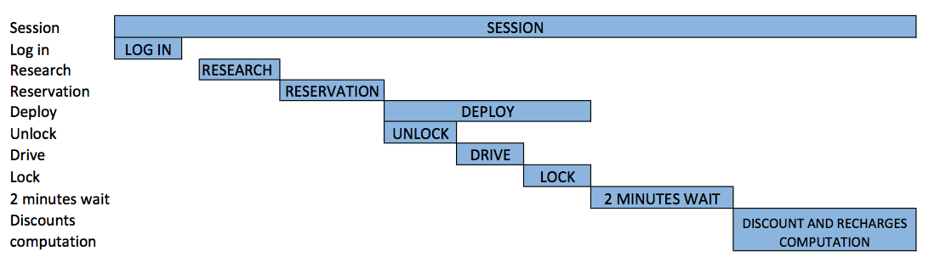
Gantt chart

Slide 15
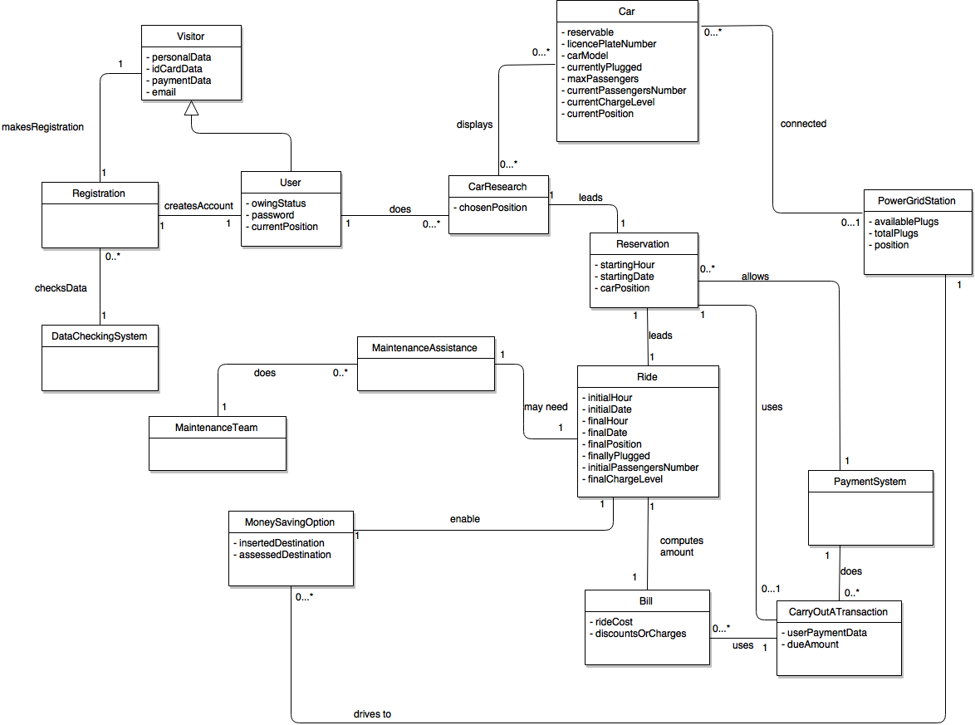
Class diagram

Slide 16
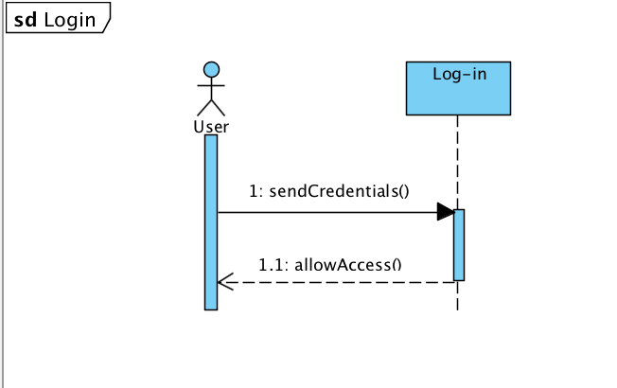
Sequence diagram – login

Slide 17
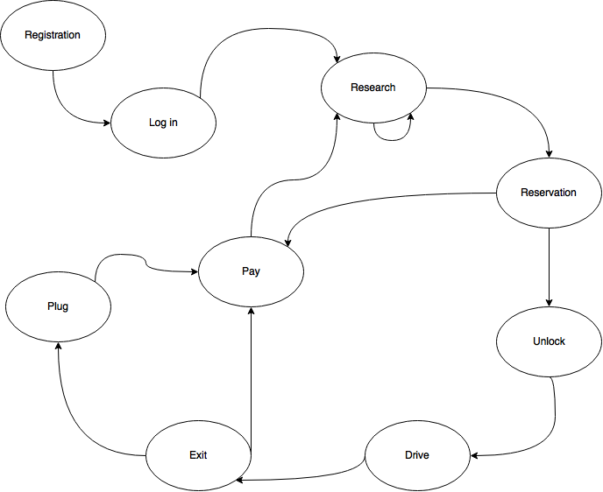
State chart – user’s phases

